Slide 1
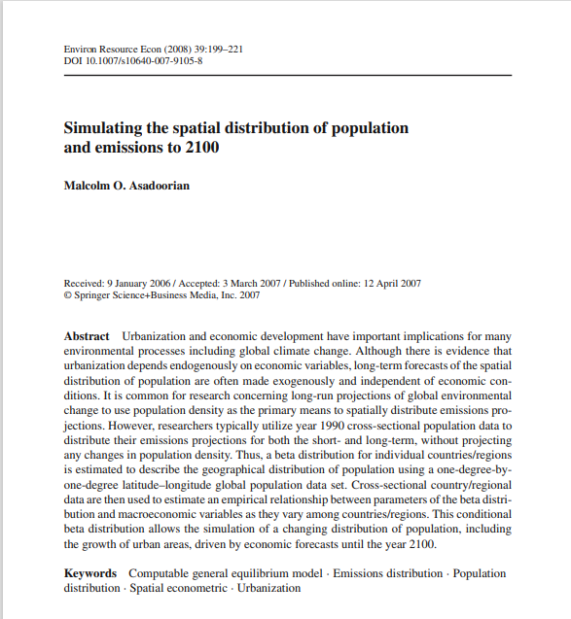
1. Simulating the spatial distribution of population and emissions to 2100
Source:
研究目标Aim: Simulating the spatial distribution of population and emissions to 2100
研究发现Findings from previous studies: The model in this paper demonstrates a more variable pattern of urban growth and urbanization across regions of the world. The ability of this model to project urban growth and urbanization represents an important step to improve the spatial distribution of emissions projections in order to examine global environmental change.
研究背景Background of this study: In order to project the distribution of emissions for purposes of generating long-run projections of global environmental change, it is critical to dynamically model the spatial distribution of population driven by forecasts of economic variables over the long-term.

Slide 2
Data 数据来源和指标
数据来源：1990年1×1◦经纬度空间人口数据；世界银行1990年(2004年)的数据；
数据指标：GDP数据，人口，劳动力和劳动生产率的增长，温室气体和主要标准空气污染物的排放量等指标

Slide 3
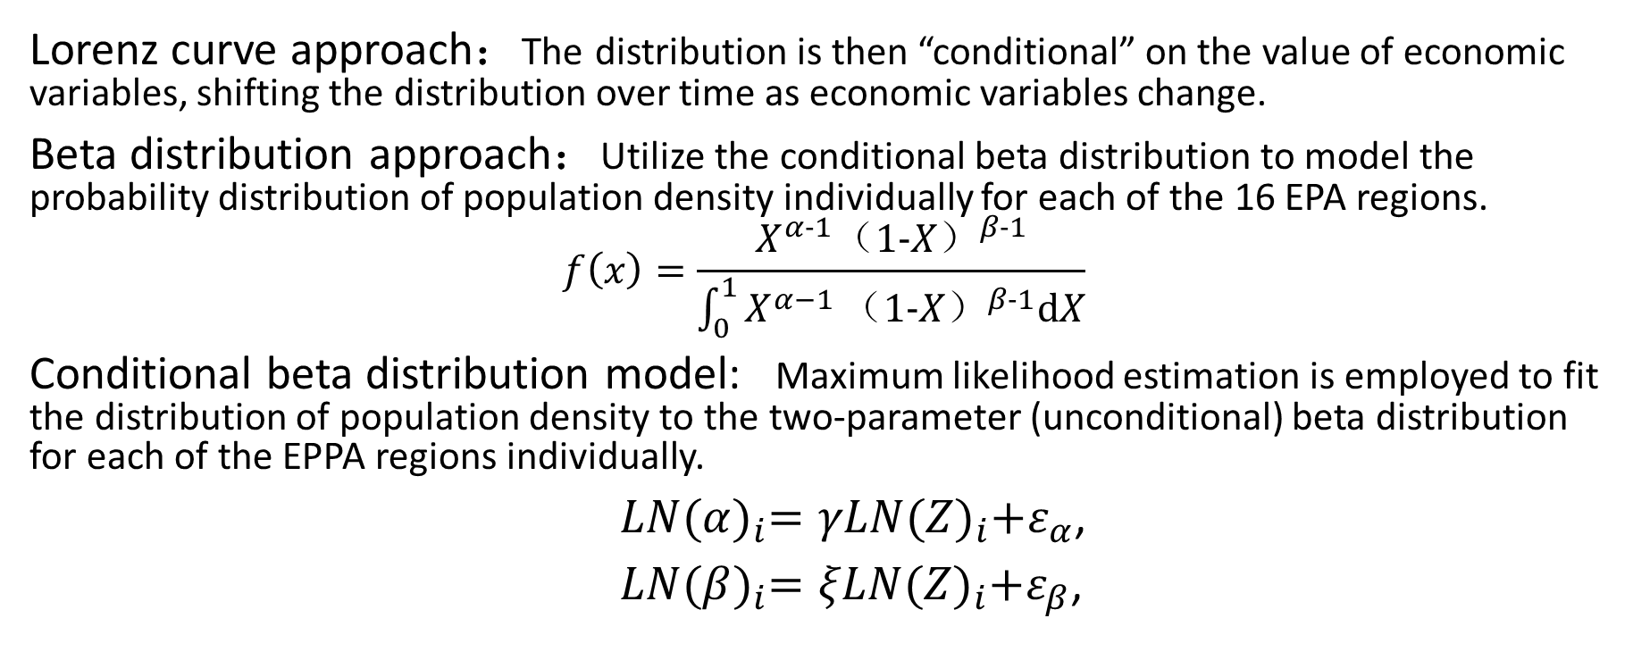
Methodology 方法
Lorenz curve approach：The distribution is then “conditional” on the value of economic variables, shifting the distribution over time as economic variables change.
Beta distribution approach：Utilize the conditional beta distribution to model the probability distribution of population density individually for each of the 16 EPA regions.
$$f\left(x\right)=\frac{X^{α−1}{（1−X）}^{β−1}}{\int_{0}^{1}{X^{α−1}}{（1−X）}^{β−1}dX}$$
Conditional beta distribution model: Maximum likelihood estimation is employed to fit the distribution of population density to the two-parameter (unconditional) beta distribution for each of the EPPA regions individually.
$LN{(α)}_{i}=γLN{(Z)}_{i}+ε_{α}$,
$LN{(β)}_{i}=ξLN{(Z)}_{i}+ε_{β}$,

Slide 4
The Flowchart for Data Analysis 数据分析流程图

Slide 5
The Workflow for Data Analysis 数据分析工作流

Slide 6
Step by Step Instructions 工作流执行步骤

Slide 7
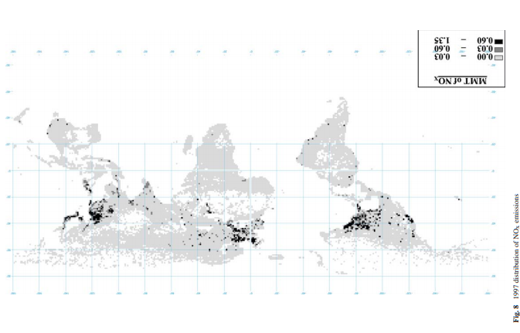
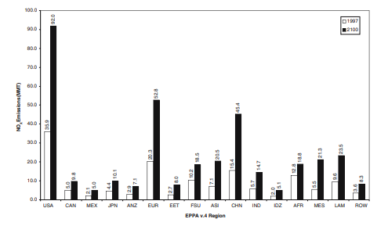
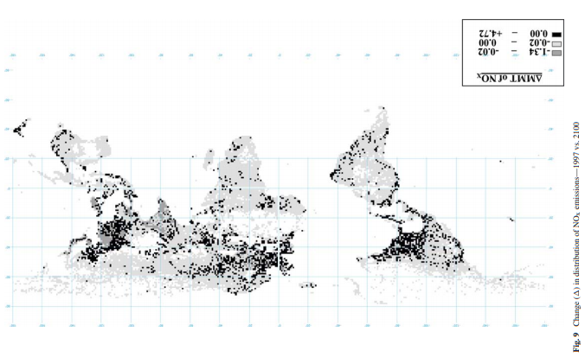
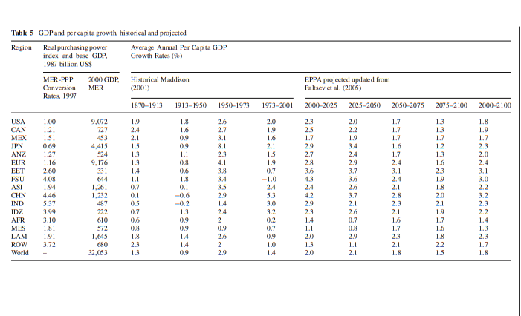
Analysis 数据分析结果

Slide 8
Conclusions and Discussions 结论和讨论
The model in this paper demonstrates a more variable pattern of urban growth and urbanization across regions of the world.
In addition, the application of this model to distribute emissions projections based on the projected distribution of population is essential. With a dynamically changing distribution of emissions, it is important to also examine the potential impact on resulting predictions of the concentrations of various pollutants utilizing the atmospheric chemistry component of the IGSM. Thus, the ability of this model to project urban growth and urbanization represents an important step to improve the spatial distribution of emissions projections in order to examine global environmental change.

Slide 9
References 参考文献
● Boccanfuso D, Decaluwe B, Savard L (2003) Poverty, income distribution and CGE modeling: does the functional form of distribution matter? (Working Paper 03–32) Centre interuniversitaire sur le risqué, les politiques economiques et l’emploi (CIRPE’E). Retrieved
July 18, 2004, from http://www.wider.unu.edu/conference/conference-2003-2/conference%202003-2-
papers/papers-pdf/Boccanfuso%20et%20al%20280403.pdf
● Brakman S, Garretsen H, van Marrewijk C (2001) An introduction to geographical economics. Cambridge
University Press, Cambridge, UK
● China Data Center (2006) China county statistics. University of Michigan, Ann Arbor, MI. Retrieved on July
13, 2006 from, http://chinadataonline.org/
● Dagum C (1977) A new model of personal income distribution: specification and estimation. Econ Appl
30:413–437
● Dimaranan BV, McDougall RA (2002) Global trade, assistance, and production: the GTAP 5 data base. Center
for global trade analysis. Purdue University, West Lafayette, IN
● Forslid R, Gianmarco Ottaviano IP (2003) An analytically solvable core-periphery model. J Econ Geogr
3:229–240
● Fujita M, Krugman P, Venables AJ (1999) The spatial economy. MIT, Cambridge, MA
● Gabaix X (1999) Zipf’s law for cities: an explanation. Q J Econ 113(3):739–767
● Gastwirth JL (1972) The estimation of the Lorenz curve and Gini index. Rev Econ Stat 54(3):306–316

Slide 10
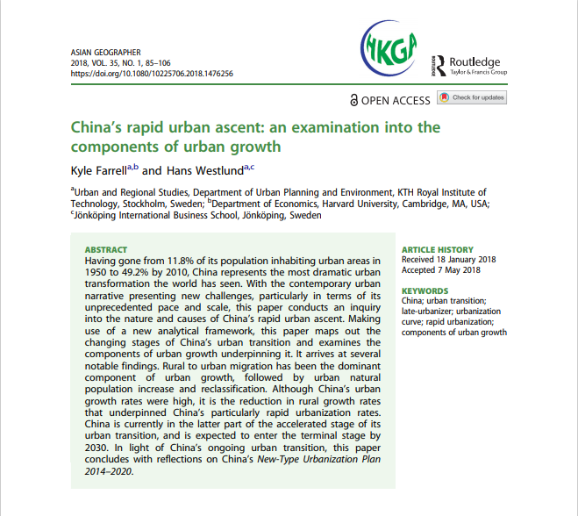
2. China’s rapid urban ascent an examination into the components of urban growth
Source:
研究目标Aim: This paper conducts an inquiry into the nature and causes of China’s rapid urban ascent.
研究发现Findings from previous studies: Rural to urban migration has been the dominant component of urban growth, followed by urban natural population increase and reclassification. Although China’s urban growth rates were high, it is the reduction in rural growth rates that underpinned China’s particularly rapid urbanization rates.
研究背景Background of this study: China is currently in the latter part of the accelerated stage of its urban transition, and is expected to enter the terminal stage by 2030. In light of China’s ongoing urban transition, this paper concludes with reflections on China’s New-Type Urbanization Plan 2014–2020.

Slide 11
Data 数据来源和指标
数据来源：联合国世界城市化前景数据库（2014年）以及中国国家统计局人口普查数据（1953、1982、1990、2000和2010）
数据指标：总人口；城镇、农村人口、城镇化级别；城乡收入比；城镇人口年增长率；城乡年均增长差异等

Slide 12
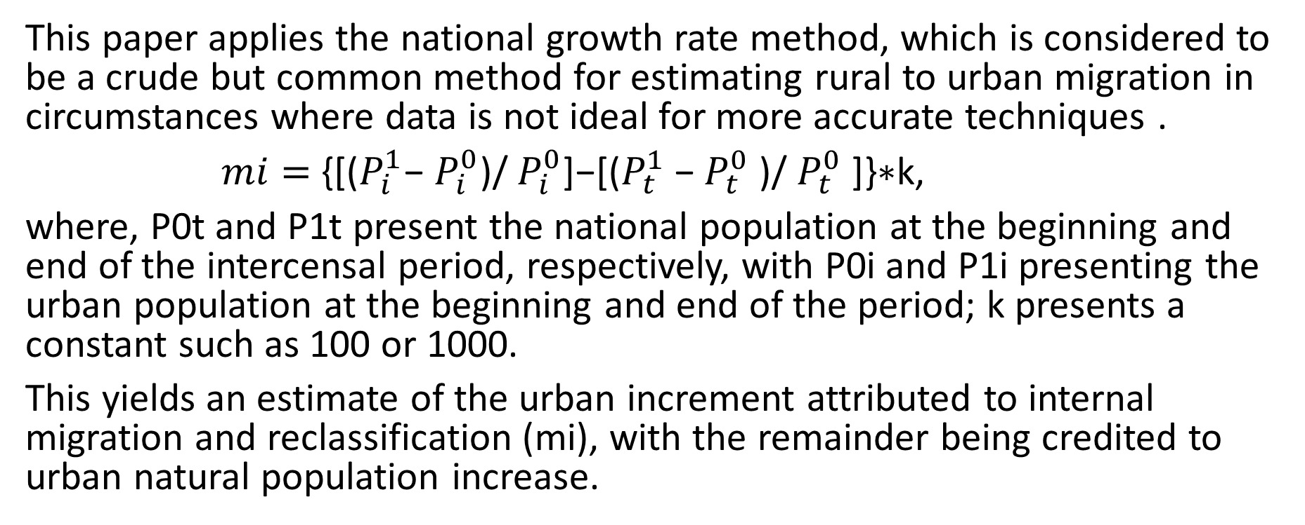
Methodology 方法
This paper applies the national growth rate method, which is considered to be a crude but common method for estimating rural to urban migration in circumstances where data is not ideal for more accurate techniques .
$mi=$ {[($P_{i}^{1}$− $P_{i}^{0}$)/ $P_{i}^{0}$]−[($P_{t}^{1}$− $P_{t}^{0}$)/ $P_{t}^{0}$]}∗k,
where, P0t and P1t present the national population at the beginning and end of the intercensal period, respectively, with P0i and P1i presenting the urban population at the beginning and end of the period; k presents a constant such as 100 or 1000.
This yields an estimate of the urban increment attributed to internal migration and reclassification (mi), with the remainder being credited to urban natural population increase.

Slide 13
The Flowchart for Data Analysis 数据分析流程图

Slide 14
The Workflow for Data Analysis 数据分析工作流

Slide 15
Step by Step Instructions 工作流执行步骤

Slide 16
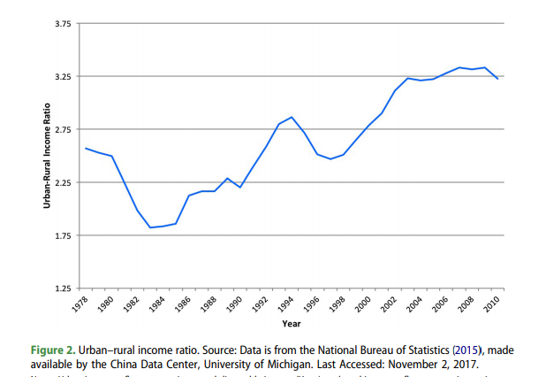
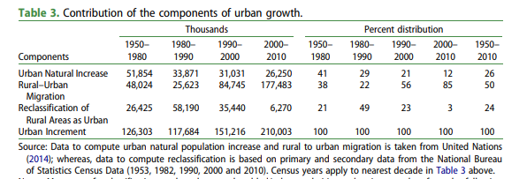
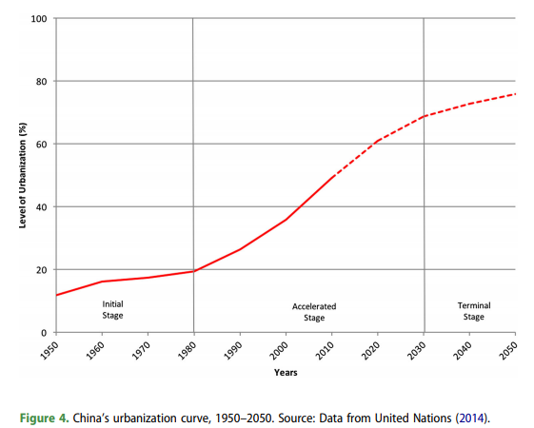
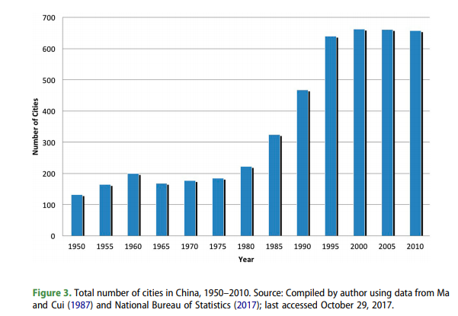
Analysis 数据分析结果

Slide 17
Conclusions and Discussions 结论和讨论
The findings of this paper have implications for national urban policy. It points to the need to view the urban transition not only as an urban phenomenon, but also as a rural one. This means that efforts need to be made to mitigate the risks posed by urban growth, and also those posed by rural decline.
Although this paper has helped to widen our understanding of the urban transition, further research in this area is needed. A comparison of the contribution of the components of urban growth among a number of countries would help to illustrate the similarities and differences as a country transitions from one stage to another. Equally as important is the need to understand how the contributions of the components of urban growth unfolded in different provinces. Finally, there is also a need to further explore the rural–urban nexus and the implications of a growing urban population accompanied by a shrinking rural population.

Slide 18
References 参考文献
Banister, J. 1997. “China: Internal and Regional Migration Trends.” Working Paper on Chinese
Politics, Economy and Society. Cologne China Studies Online, 14, 1–18.
Bhagat, R. 2012. “A Turnaround in India’s Urbanization.” Asia-Pacific Population Journal 27 (2):23–39.
Brinkhoff, T. 2018. “City Population: People’s Republic of China.” Accessed January 7, 2018. http://www.citypopulation.de.
Brockerhoff, M. 2000. “An Urbanizing World.” Population Bulletin 55 (3): 1–44.
Cai, F. 2010. “Demographic Transition, Demographic Dividend, and Lewis Turning Point in
China.” China Economic Journal 3 (2): 107–119.
Chan, K. 1994. Cities with Invisible Walls. Hong Kong: Oxford University Press.
Chan, K. 2014. “China’s Urbanization 2020: A New Blueprint and Direction.” Eurasian Geography and Economics 55 (1): 1–9.
Chan, K., V. Henderson, and K. Tsui. 2003. “Spatial Dimensions of Chinese Economic Development.” In China’s Great Economic Transformation, edited by L. Brandt and T. Rawski, 776–828. Cambridge: Cambridge University Press.
Chan, K., and L. Zhang. 1999. “The Hukou System and Rural-Urban Migration in China: Processes
Chauvin, J., E. Glaeser, Y. Ma, and K. Tobio. 2017. “What is Different about Urbanization in Rich and Poor Countries? Cities in Brazil, China, India and the United States.” Journal of Urban Economics 98: 17–49.
Chen, N., P. Valente, and H. Zlotnik. 1998. “What Do We Know About Recent Trends in Urbanization?” In Migration, Urbanization and Development: New Directions and Issues, edited by R. Bilsborrow, 59–88. New York: United Nations Fund for Population Activities.

Slide 19
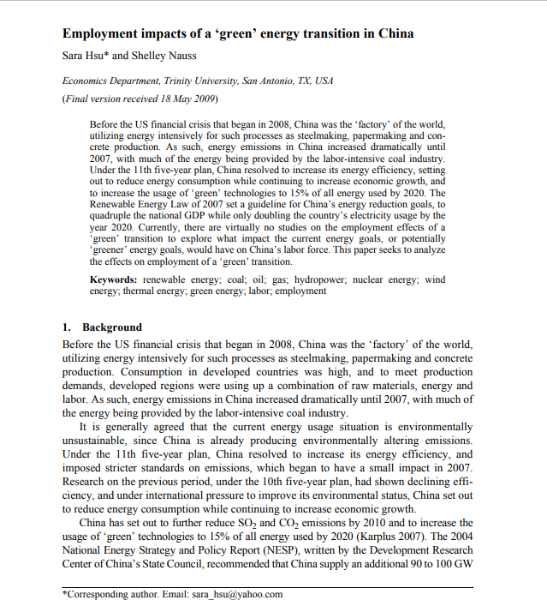
3. Employment impacts of a ‘green’ energy transition in China
Source:
研究目标Aim: This paper seeks to analyze the effects on employment of a ‘green’ transition.
研究发现Findings from previous studies: Religious diversity may have positive or negative impacts on economic development
研究背景Background of this study: Under the 11th five-year plan, China resolved to increase its energy efficiency, setting out to reduce energy consumption while continuing to increase economic growth, and to increase the usage of ‘green’ technologies to 15% of all energy used by 2020. Currently, there are virtually no studies on the employment effects of a ‘green’ transition to explore what impact the current energy goals, or potentially ‘greener’ energy goals, would have on China’s labor force.

Slide 20
Data 数据来源和指标
数据来源：中国能源统计年鉴(2007);美国能源部；中国地图
数据指标：风力发电、太阳能发电、火电；平均劳动力产出等

Slide 21
The Flowchart for Data Analysis 数据分析流程图

Slide 22
The Workflow for Data Analysis 数据分析工作流

Slide 23
Step by Step Instructions 工作流执行步骤

Slide 24
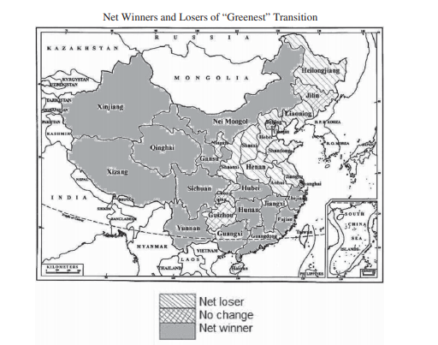
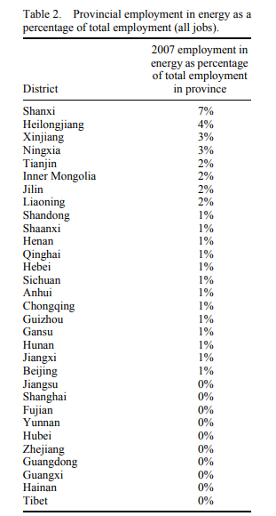
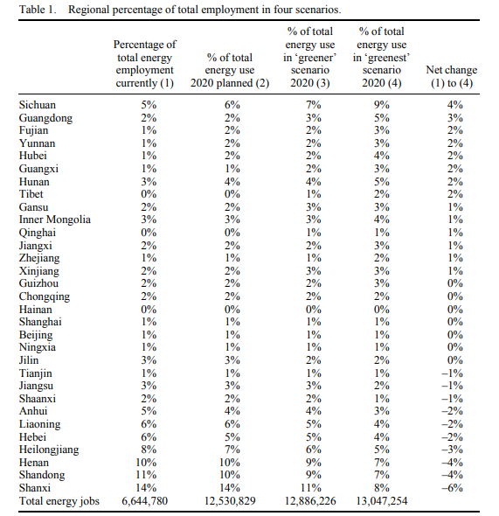
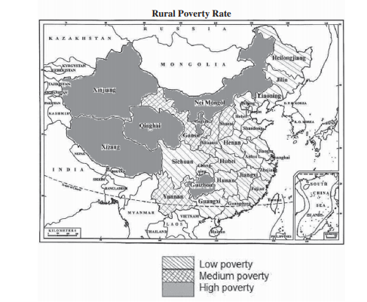
Analysis 数据分析结果

Slide 25
Conclusions and Discussions 结论和讨论
Although China has set out to improve its current energy regime, there is no guarantee that it will change its energy industry enough to offset global warming. Part of the hesitation to shift into greener energy is due to concern over job losses and restructuring.
This paper has sought to explore employment considerations in a greener transition, and finds that restructuring China’s energy industry would offset not only global warming, but extreme poverty as well.

Slide 26
References 参考文献
Biello, D. 2008. China’s big push for renewable energy. Scientific American, August 4. http://www.sciam.com/article.cfm?id=chinas-big-push-for-renewable-energy (accessed December 20,2008).
Cha, A.E. 2008. Solar energy firms leave waste behind in China. Washington Post, March 9.
Chen, G.Q., and B. Chen. 2007a. Resource analysis of the Chinese society 1980–2002 based on energy – Part 1: Fossil fuels and energy minerals. Energy Policy 35, no. 4: 2038–50.
Chen, G.Q., and B. Chen. 2007b. Resource analysis of the Chinese society 1980–2002 based on energy – Part 2: Renewable energy sources and forest. Energy Policy 35, no. 4: 2051–64.
Cherni, J.A., and J. Kentish. 2007. Renewable energy policy and electricity market reforms in China. Energy Policy 35, no. 7: 3616–29.
China Daily. 2009. China oil consumption up 12% in 2008. China Daily, January 27. http://www.china.org.cn (accessed March 10, 2009).
China Data Online. http://chinadataonline.org
China Energy Statistical Yearbook. 2007. Energy Bureau of National Development and Reform Commission. Beijing: China Research Press.
China Industrial Yearbooks. 2000–2008. Beijing: China Yearbook Press.
China National Yearbook. 2007. National Bureau of Statistics. Beijing: China Statistics Press.
CPCIA. 2009. China Petroleum and Chemical Industry Association. http://www.cpcia.org.cn (accessed on 5 March 2009).
Department of Energy. 2008. U.S. Department of Energy. http://www.energy.gov (accessed March 5, 2009).
Downs, E. 2006. The Brookings foreign policy studies energy security series: China. The Brookings Institution, December 2006. http://www.brookings.edu (accessed March 12, 2009).

Slide 27
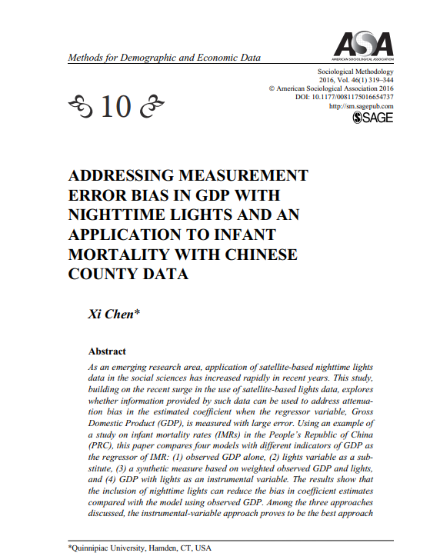
4. Addressing Measurement Error Bias in GDP with Nighttime Lights and an Application to Infant Mortality with Chinese County Data
Source:
研究目标Aim: The primary goal of this article is to explore how lights data can be included in a regression model that reduces the bias in coefficient estimates of GDP.
研究发现Findings from previous studies: The study concludes that nighttime lights data have great potential to be used in other sociological research areas facing estimation bias problems due to measurement errors in economic indicators.
研究背景Background of this study:Conducting empirical studies with local-level economic or demographic data is often problematic for developing countries, which tend to have relatively poor statistical systems.

Slide 28
Data 数据来源和指标
数据来源：China Data Online(chinadataonline.org)中国在线数据；
数据指标：中国2000年人口普查；县域统计GDP数据；夜灯光数据等

Slide 29
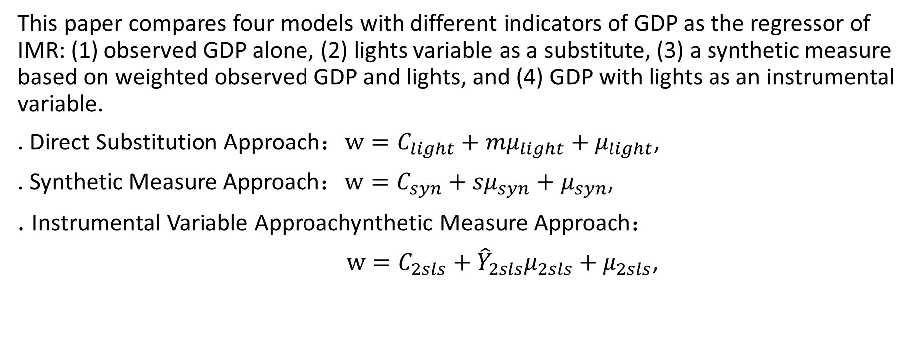
Methodology 方法
This paper compares four models with different indicators of GDP as the regressor of IMR: (1) observed GDP alone, (2) lights variable as a substitute, (3) a synthetic measure based on weighted observed GDP and lights, and (4) GDP with lights as an instrumental variable.
. Direct Substitution Approach：$w=C_{light}+{mμ}_{light}+μ_{light}$,
. Synthetic Measure Approach：$w=C_{syn}+{sμ}_{syn}+μ_{syn}$,
. Instrumental Variable Approachynthetic Measure Approach：
$w=C_{2sls}+{{\hat{Y}}_{2sls}μ}_{2sls}+μ_{2sls}$,

Slide 30
The Flowchart for Data Analysis 数据分析流程图

Slide 31
The Workflow for Data Analysis 数据分析工作流

Slide 32
Step by Step Instructions 工作流执行步骤

Slide 33
Step by Step Instructions 工作流执行步骤

Slide 34
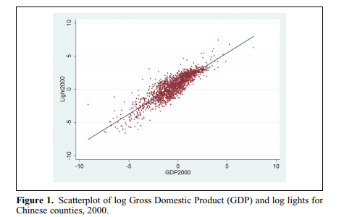
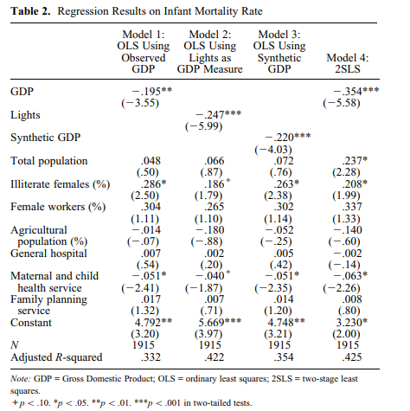
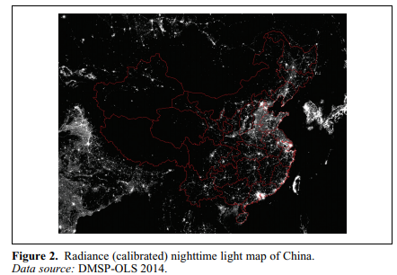
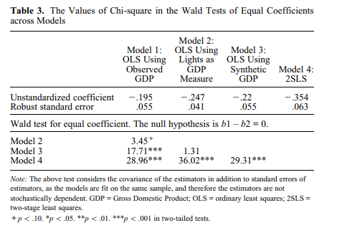
Analysis 数据分析结果

Slide 35
Conclusions and Discussions 结论和讨论
This study is the first to show that nighttime lights data can be used to address estimator bias issues due to measurement error in a regressor. It further points out the wide range of possible applications of nighttime lights in sociological studies.
When lights information is added in one form or another, improvement in the estimated economic effect and overall model fit can be substantial, compared with models that use only observed economic data. In the case of Chinese IMR studies, the improvement in the instrumental variable approach is most significant.

Slide 36
References 参考文献
Babones, Salvatore J. 2013. Methods for Quantitative Macro-comparative Research. Thousand Oaks, CA: Sage Publications.
Bharti, Nita, Andrew J. Tatem, Matthew Ferrari, Rebeeca Grais, Ali Djibo, and Bryan Grenfell. 2011. “Explaining Seasonal Fluctuations of Measles in Niger Using Nighttime Lights Imagery.” Science 334(6061):1424–27.
Chen, Xi, and William Nordhaus. 2011. “Using Luminosity Data as a Proxy for Economic Statistics.” The Proceedings of National Academy of Sciences 108(21): 8589–94.
Chen, Xi. 2015. “Explaining Subnational Infant Morality and Poverty Rates: What Can We Learn from Night-time Lights?” Spatial Demography 3(1):27–53.
Chen, Xi. 2016. “Using Nighttime Lights Data as a Proxy in Social Scientific Research.” Pp. 301–23 in Recapturing Space: New Middle-range Theory in Spatial Demography, edited by F. Howell, J. Porter, and S. Matthews. New York: Springer International.
DMSP-OLS. 2015. “National Defense Meteorological Satellite Program, Image and Data processing by NOAA’s National Geophysical Data Center. DMSP data collected by the US Air Force Weather Agency.” Retrieved April 10, 2015 (http://www.ngdc.noaa.gov/dmsp/dmsp.html).
Doll, Christopher, Jan-Peter Muller, and Christopher Elvidge. 2000. “Nighttime Imagery as a Tool for Global Mapping of Socio-economic Parameters and Greenhouse Gas Emissions.” Ambio 29(3):157–62.
Ebener, Steve, Christopher Murray, Ajay Tandon, and Christopher Elvidge. 2005. “From Wealth to Health: Modeling the Distribution of Income per Capita at the Sub-national Level Using Night-time Light Imagery.” International Journal Health Geographics 4(1):5–14.
Elvidge, Christopher D., Kimberly E. Baugh, Eric Kihn, Herbert Kroehl, E. R. Davis, and C. W. Davis. 1997. “Relation Between Satellites Observed Visible-near Infrared Emissions, Population, Economic Activity and Electric Power Consumption.”International Journal of Remote Sensing 18(6):1373–79.

